Slide 1
Game Design Documents
Introductions

Slide 2
Why Make a GDD
Clarity
Communication
Prototyping

Slide 3
Mechanics, Assets and Gameplay
Mechanics - Rules of the game
Asset - What makes the game (Programs, sounds, models, sprites etc)
Gameplay - The player experience when mechanics and assets are combined

Slide 4
Introduction (Pitch)
Short and Succinct description of the game
Tells people why the game is important and what stands out
Does it have to be words?
Examples
“Ridiculous Fishing is a game about fishing with machine guns.” - Vlambeer
“Shovel Knight is a sweeping classic action adventure game with awesome gameplay, memorable characters, and an 8-bit retro aesthetic” - Yach-Club Games

Slide 5
Description
Describe the gameplay experience - what the player does in a typical session
Tends to use second person perspective - “you do this, you do that”
Does not get technically specific, just enough to highlight mechanics

Slide 6
Key Features
Short bullet points that make this game remarkable

Slide 7
Genre
Lets people know where this game will exist in the current marketplace
This section allows developers to show how the game can stand out from the chosen genre

Slide 8
Platforms
What will this game ship to?
What design considerations will be made to suit different platforms

Slide 9
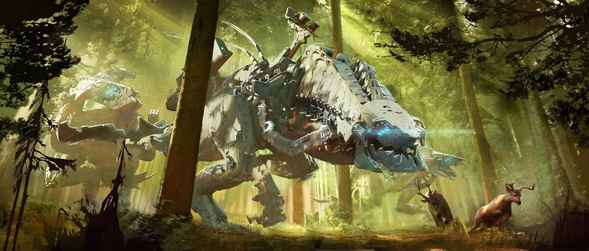
Concept Art
Visual representation of the aesthetics
Visual representation of UI layout
Screenshot mockups
Adds Clarity
Captures Mood
Horizon Zero Dawn - 2017 - Guerilla Games

Slide 10
Target Market
Who is this Game for?

Slide 11
Title Comparisons
What other games are similar?
Specific similarities?
What make those similar features so special?
What sets your game apart?

Slide 12
Technical Features
What technical development will be undertaken in the project
Graphics, AI, Level building tools, physics etc
What programs will need to be written (character controls, environment interaction etc)

Slide 13
Resources
Team roles needed for project
Team size
Tools used
Assets needed

Slide 14
Schedule
How long will it take
Prototype
Playtest
Alpha, Beta, Final release

Slide 15
Positioning Your Game
Why should this game be made
What makes this game remarkable
What parts of play are you trying to appeal to the player
What mechanics/assets are appealing to this player

